Slide 1
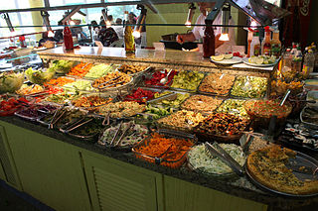
Bienvenue au bar à salade épigénétique

Slide 2
Methods
Recommendations for handling cellular heterogeneity in buccal DNAm.
How to use public resources for causal inference in Epigenetic Epidemiology of Neurodevelopment and Mental Health (by Esther, Caroline and Doretta).
Long-read nanopore sequencing identifies new imprinted regions in mouse.

Slide 3
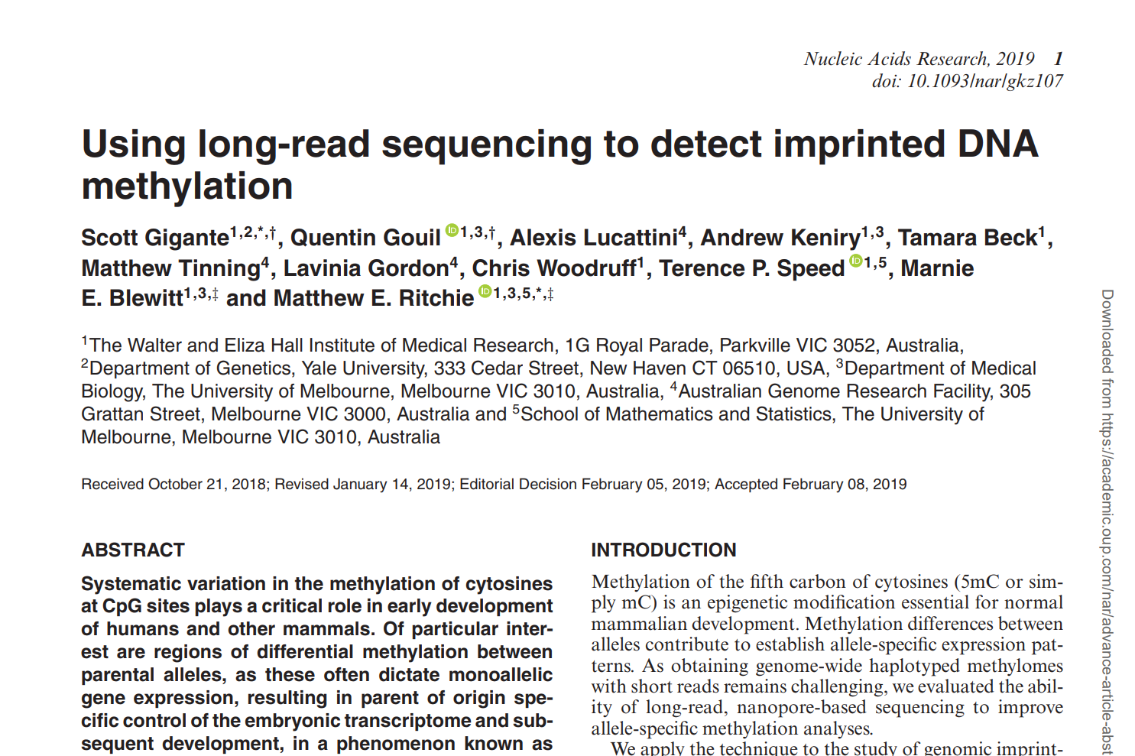

Slide 4
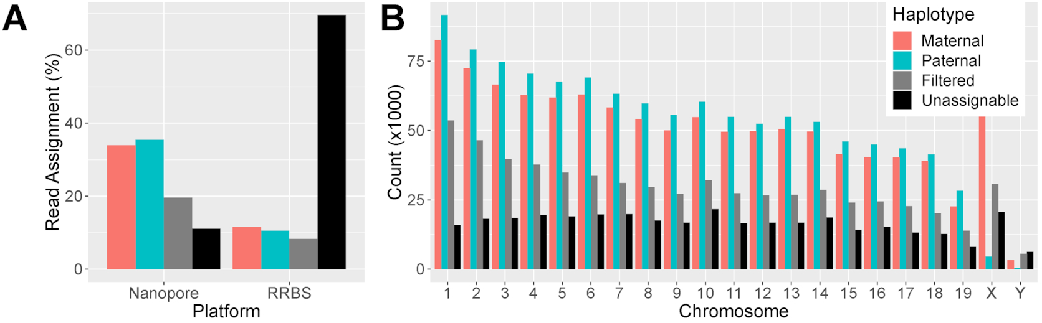
Long reads allow parent assignment
Filtered = could not be assigned with sufficiently high confidence
Unassignable = no genetic difference between maternal and paternal genotypes

Slide 5
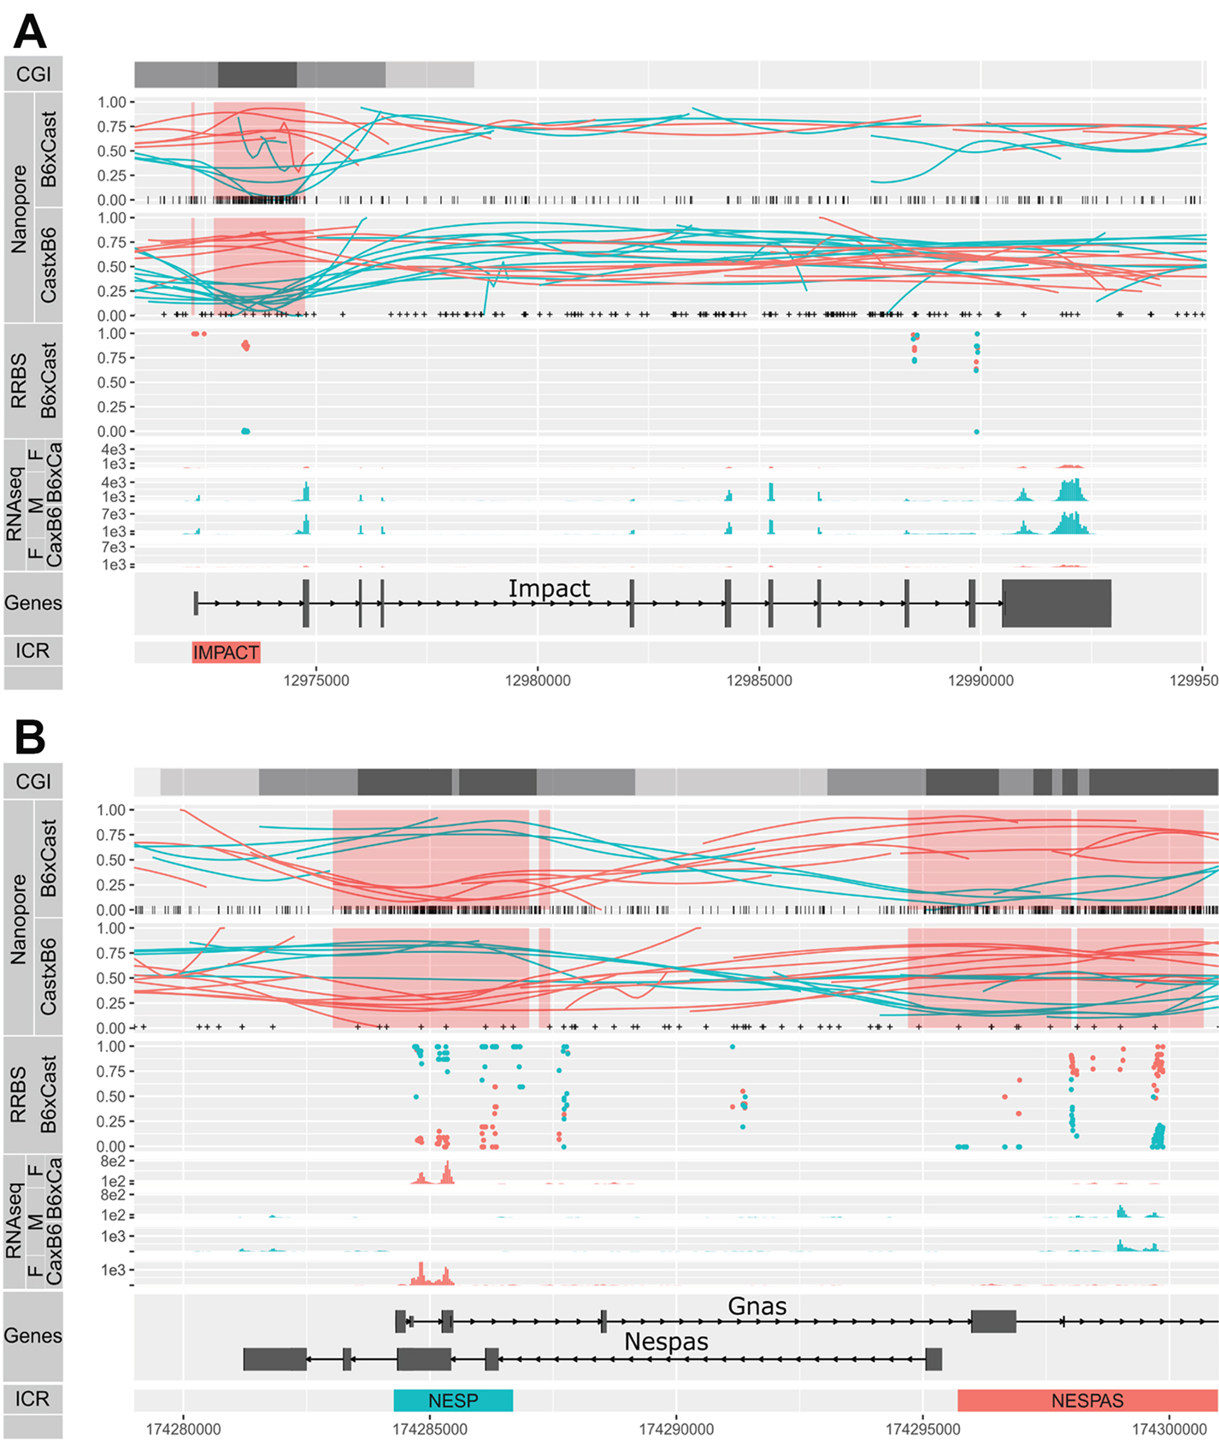
Old ICRs confirmed, some new discovered
Of the 20 highest ranking DMRs, 15 corresponded to known ICRs.
They identified 309 DMRs with parent-of-origin differences.

Slide 6
Candidate gene studies
BDNF associated with combat and exercise in veterans.
Is it okay to do candidate gene studies using genome-wide DNAm profiles?

Slide 7
EWAS
Air pollution in cord and placenta.
Air pollution in adult peripheral blood.
Alcohol use disorder associated with CpG sites associated with brain insular surface area.
Orofacial clefts and newborn blood. Fail to replicate findings based on ALSPAC and the Cleft Collective.
Preterm birth and maternal blood. Includes whole genome sequencing and RNA-seq.
Periodontitis in blood, buccal and adipose tissue (Twins UK).
Childhood lung function and risks of asthma and COPD in cord blood (meta-analysis of 5 cohorts). The approach used is prone to false positives.
BMI and adolescent peripheral blood leukocytes. No tests survive adjustment for multiple tests, but functions of top genes 'make sense'.
Socio-economic position in young adult blood.​ 2546 associations! Study performed in a non-affluent Philippine population.​
Paternal pre-pregnancy obesity and offspring cord blood.​ Observed sex-specific associations. However, strongest association TAPBP was not replicated.​
Insulin resistance and peripheral blood.​ 798 CpG site associations observed!​
Hepatic fat and peripheral blood.​ Observe 22 CpG site associations in 3,400 European, 401 Hispanic and 724 African ancestry participants.​
Folic acid supplementation during pregnancy (RCT) linked to differentially methylated regulator of ZPF57 in cord blood.​

Slide 8
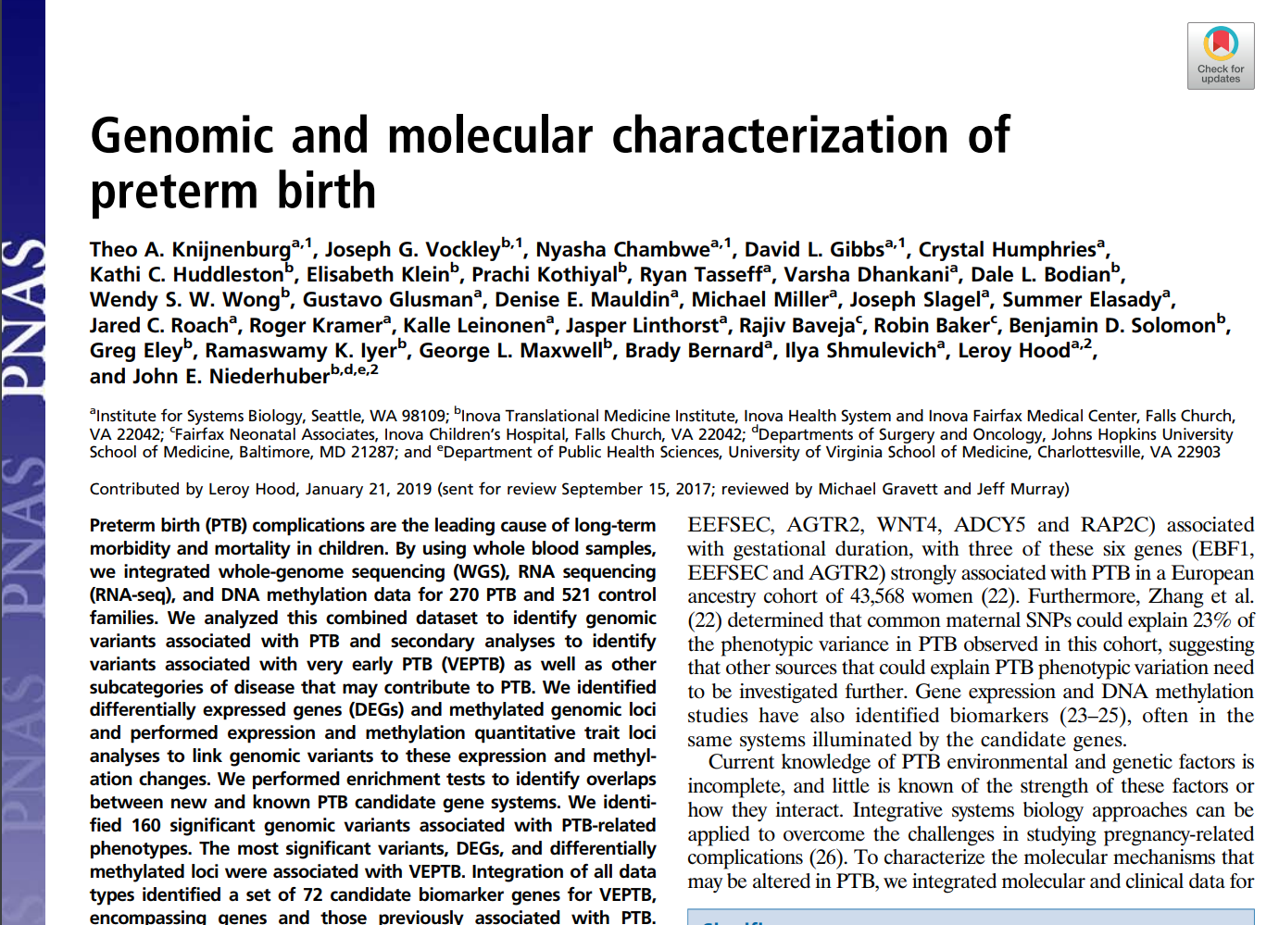

Slide 9
Clinical phenotype | Genomic |  |  | Molecular
 | FBAT | EIGENSTRAT |  | DNA methylation |  | mRNA | miRNA
 | Family trio | Maternal | FBAT + EIGENSTRAT | Maternal
 | No. of variants | No. of variants | No. of genes | No. of probes | No. of genes | No. of genes | No. of miRNAs
PTB | — | — | — | 2 | 2 | 215*,†,‡ | —
EPTB | 3 | 42 | 7 | 273 | 258* | 650*,†,‡,§ | —
VEPTB | 7 | 960 | 217*,†,§ | 811 | 735 | 838*,†,‡ | —
PROM | 23 | 3 | 12 | — | — | — | —
Pre-eclampsia | 78 | 1046 | 312*,§ | — | — | 8 | —
Idiopathic PTB | 1 | 10 | 3 | 11 | 11 | 17 | —
Placenta-related | 13 | — | 10 | — | — | — | —
Uterine-related | 105 | 276 | 132§ | — | — | — | —
Cervix-related | 28 | 16 | 18 | — | — | — | —
72 genes with strong genomic associations or with associations in at least two of genetic/DNAm/mRNA

Slide 10
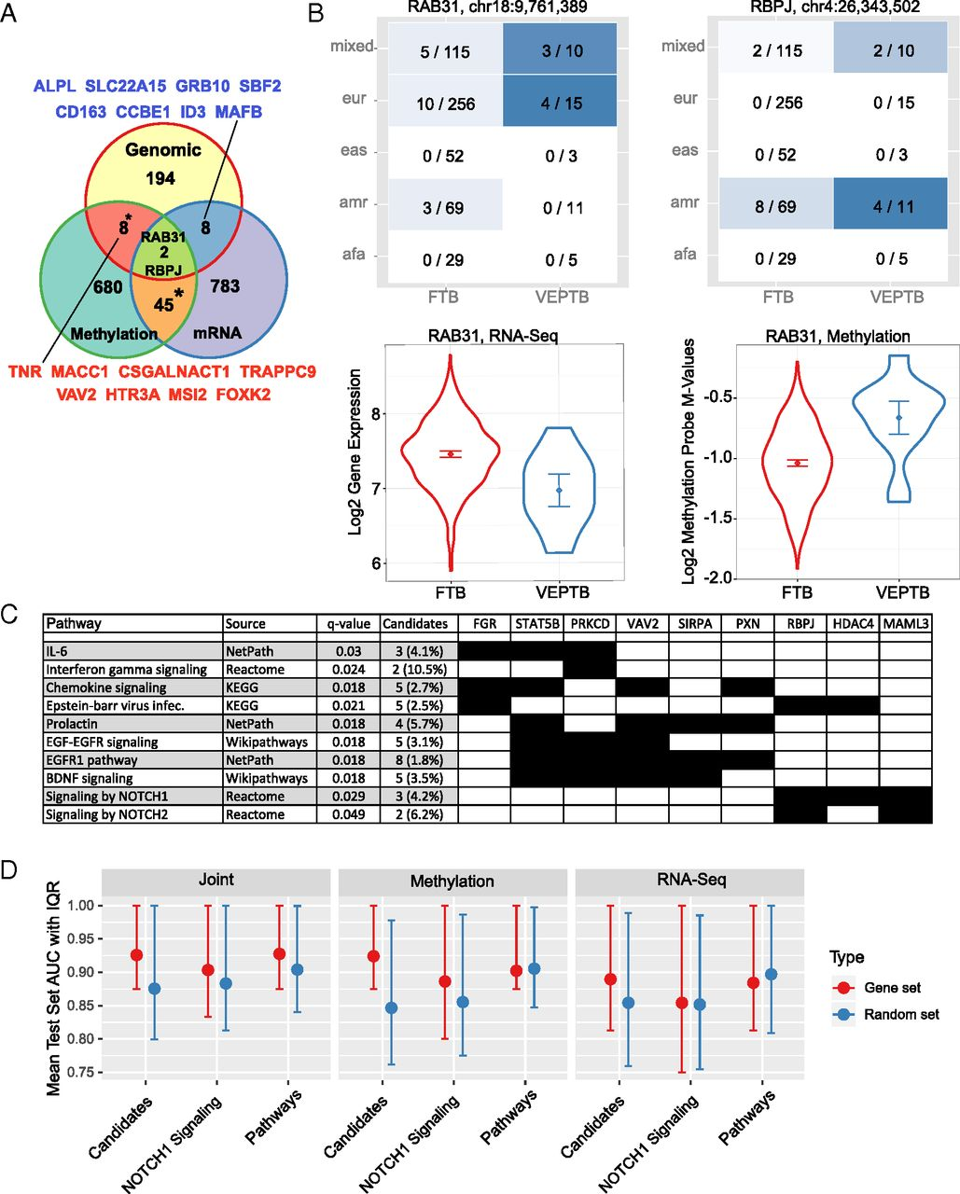
92% (66 of 72) have not been previously reported to be associated with PTB.
RAB31 and RBPJ have been linked to PTB.
"VEPTB status could be predicted by the VEPTB pathway genes with similar accuracy compared with the original 72 VEPTB genes, and, in both cases, much better than with random gene sets"
"PTB is thought to result from aberrations in systems such as inflammatory, immune-related, and hormone regulation pathways"

Slide 11
DNAm scores
BMI score associated with health and disease in LBC.
DNAm age
Developmental stage at least partially independent of DNAm age in mammalian neural retina.
Y-chromosome derived DNAm age is different from autosomally-derived DNAm age. DNAm levels tend to increase with age, accelerate in the oldest individuals and associate negatively with mortality.
Longitudinal DNAm
Generalized estimating equestion (GEE) models used to investigate smoking and DNAm at two time points. Smokers tended to have greater DNAm change which was almost always linked to reduced DNAm levels.

Slide 12
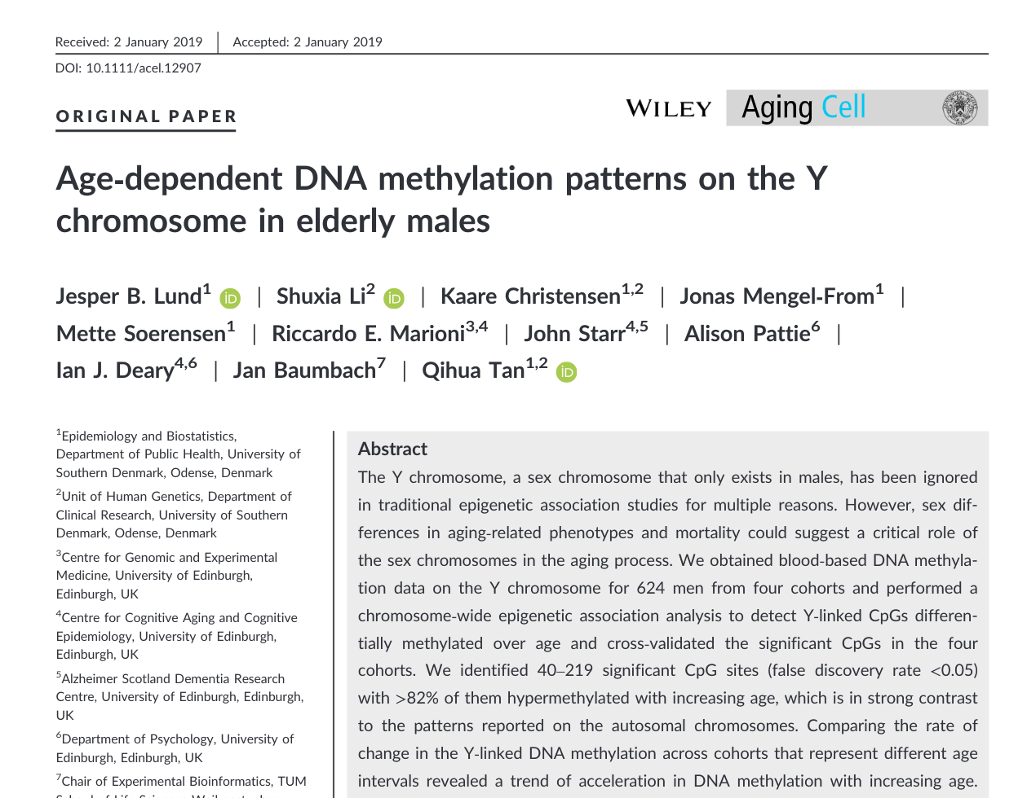
… of 416 total

Slide 13
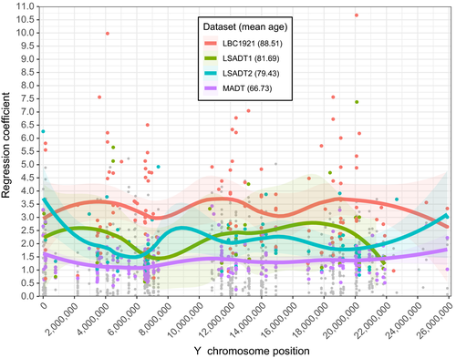
Regression coefficients of age vs methylation

Slide 14
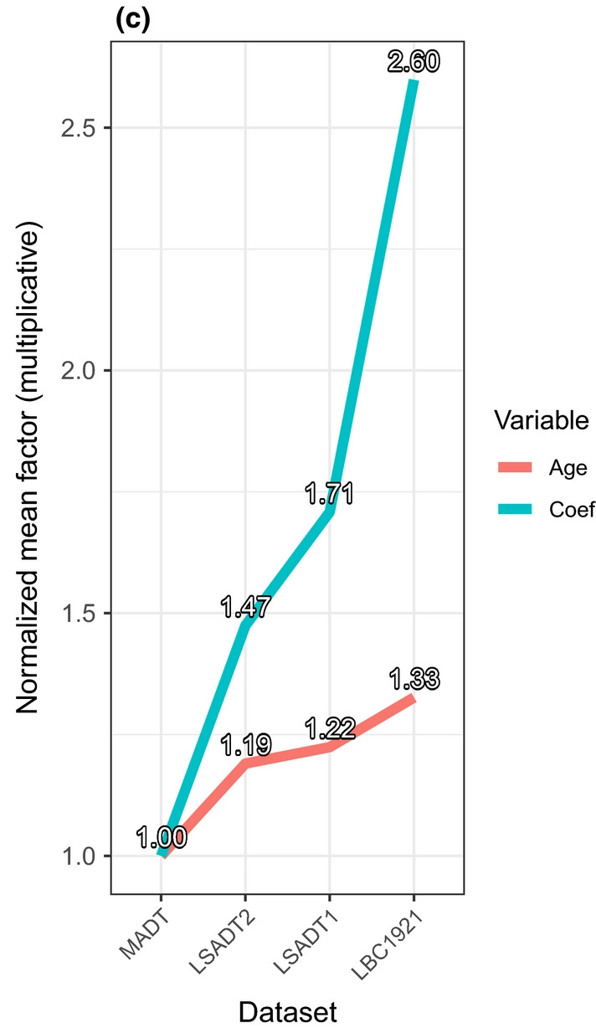
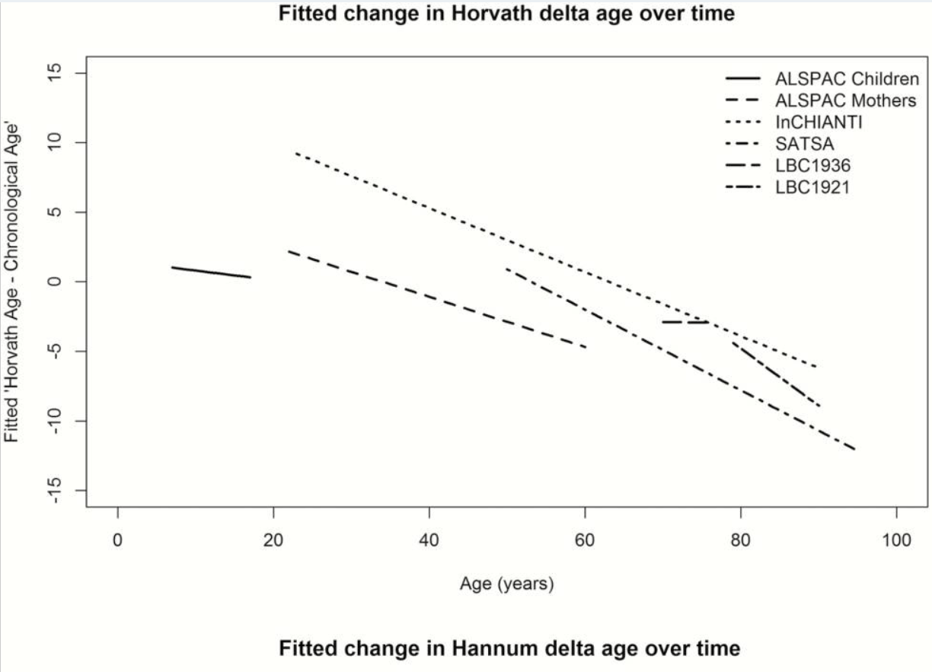
Regression coefficients 'accelerate' with age
cf. Tracking the Epigenetic Clock Across the Human LifeCourse: A Meta-analysis of Longitudinal Cohort Data.

Slide 15
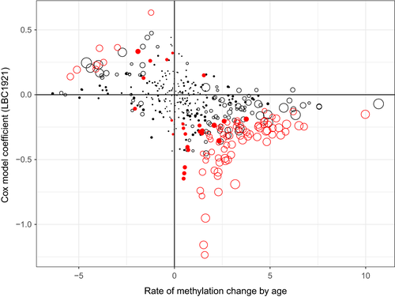
CpG sites positively associated with age tend to be negatively associated with mortality
The empty dots are CpGs significantly methylated with age (FDR <0.05, the larger the dots the higher the statistical significance).
The red dots are CpGs associated with mortality with p < 0.05 in the Cox regression model.
There are 74!

